Slide 1
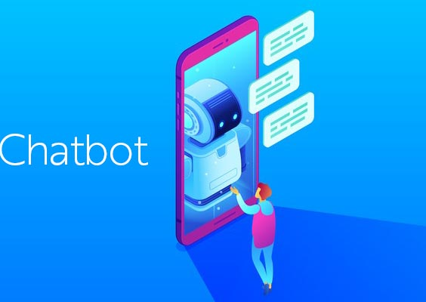
Revolutionizing Customer Support and Payment Processes: Crafting an Efficient and User-Friendly Chatbot for Debtors

Slide 2
Introduction
In this presentation, we will delve into the advantages of creating a highly efficient and user-friendly chatbot tailored for debtors, aimed at elevating customer support and optimizing payment processes. The presentation will feature a brief, professional demonstration of the chatbot prototype, highlighting its functionality and user interface.

Slide 3
Challenges in Customer Support
Debtors frequently seek personalized assistance and prompt responses, placing a strain on customer support teams. Implementing a chatbot can effectively address these challenges, providing 24/7 support and automating routine queries. This strategic integration enables support agents to concentrate on resolving complex issues.

Slide 4
Streamlining Payments with
Chatbot
The chatbot seamlessly integrates real-time payment gateways, streamlining payment processing and offering personalized payment plans. This not only enhances the debtor experience but also significantly improves the efficiency of payment collections.

Slide 5
Chatbot Functionality
User-Friendly Interface:
Intuitive design for easy navigation.
Simplified user experience to engage debtors effectively.
Inquiry Handling:
Instant response to debtor inquiries.
Natural language processing for understanding diverse queries.
Payment Processing:
Real-time payment gateways for seamless transactions.
Support for pending payments with multiple options.
24/7 Support:
Round-the-clock availability for debtor assistance.
Automated responses for timely support.

Slide 6
Chatbot Prototype Demonstration

Slide 7
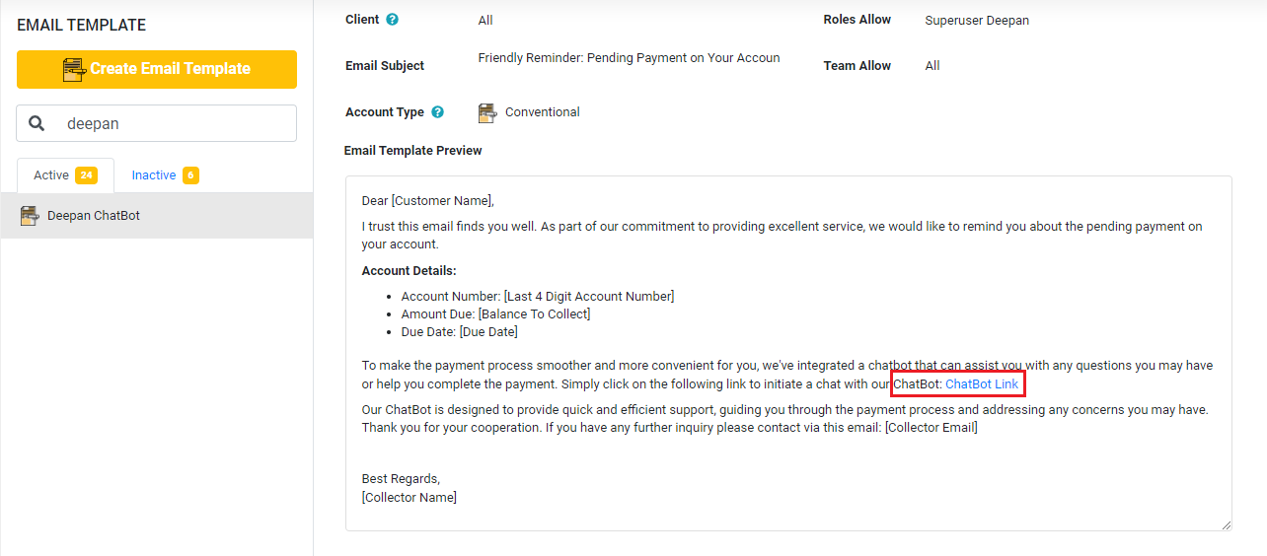
Access To Chatbot
Collectors will initiate contact with debtors through personalized emails or messages, providing a convenient link for accessing the chatbot interface.

Slide 8
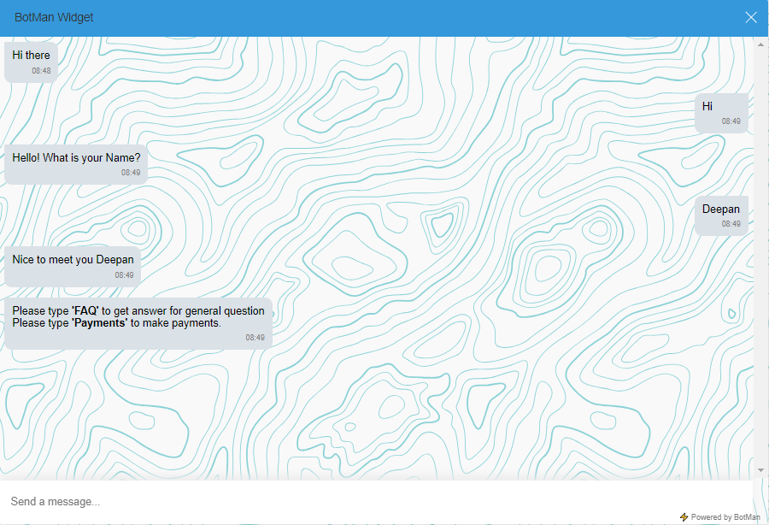
Chatbot Conversation Flow
Listens for user input and processes messages.
Greetings and Initial Options:
'Hi': Asks for the user's name.
'FAQ': Provides a list of frequently asked questions.
'Payments': Collects information for debt-related queries.

Slide 9
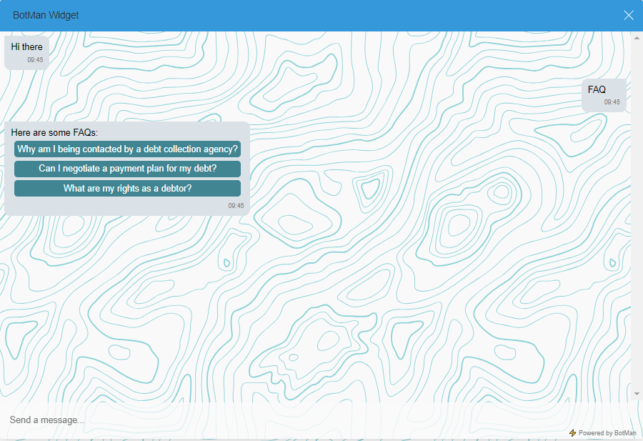
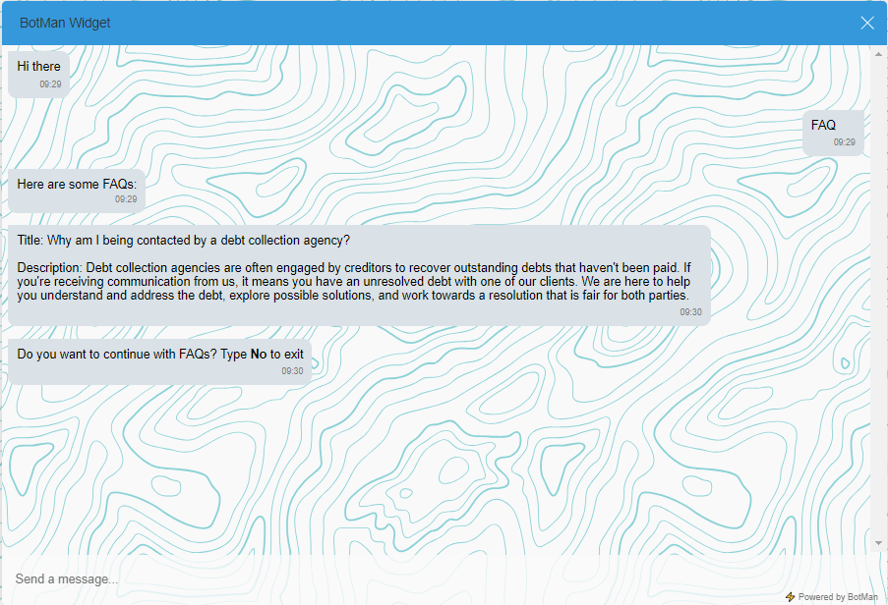

FAQ Chatbot Interaction
Users can inquire about frequently asked questions (FAQs) through the chatbot by typing FAQ
Chatbot displays a list of FAQs.
User selects a FAQ by clicking on the corresponding button.

Slide 10
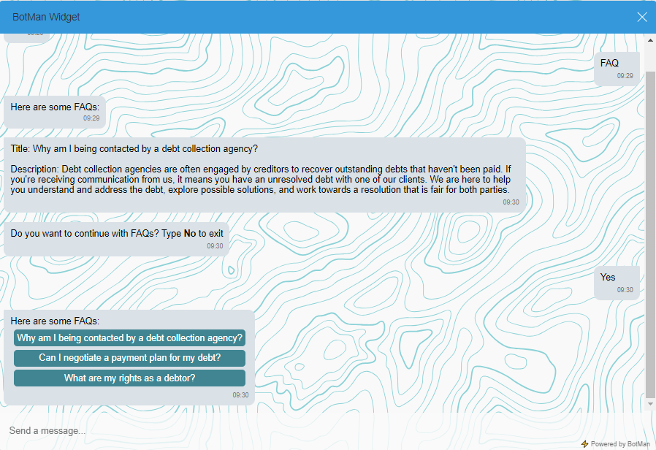
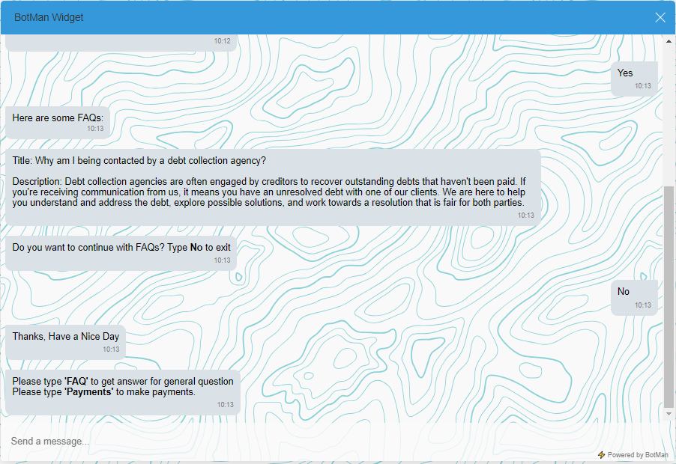
FAQ Chatbot Interaction
Chatbot inquires if the user wants more FAQs.
Conversation ends if the user types 'No'; otherwise, it continues.
If the user exits, the chatbot expresses gratitude and provides additional information.
If the user continues, the chatbot repeats the process.

Slide 11
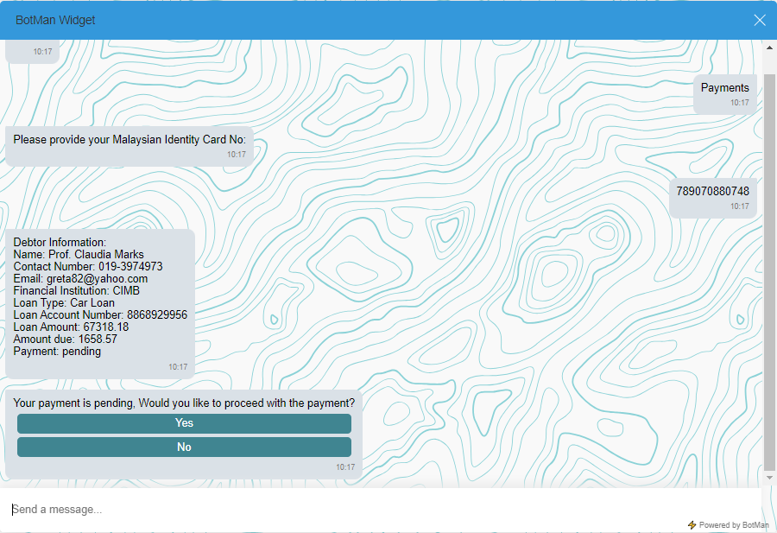
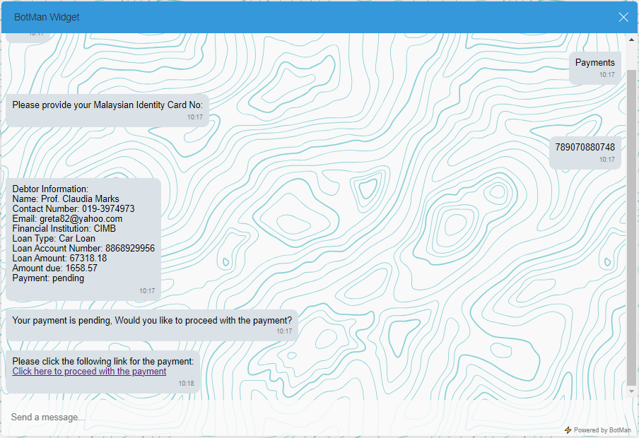
Debtor Information and Payment Chatbot Interaction
Chatbot prompts the user to provide their Malaysian Identity Card Number.
Chatbot queries the database for debtor information based on the provided IC Number and Displays debtor details
If a pending payment is detected, the chatbot prompts the user with options to proceed with payment.
If 'Yes' is selected, chatbot generates a payment link.

Slide 12
CONCLUSION
Strategically investing in the development of an efficient and user-friendly chatbot for debtors is a pivotal move to elevate customer support and streamline payments. Through the adept use of advanced technologies, organizations can elevate debtor satisfaction, boost payment collections, and optimize operational efficiency.

